Slide 1
Motorola APX8000XE

Slide 2
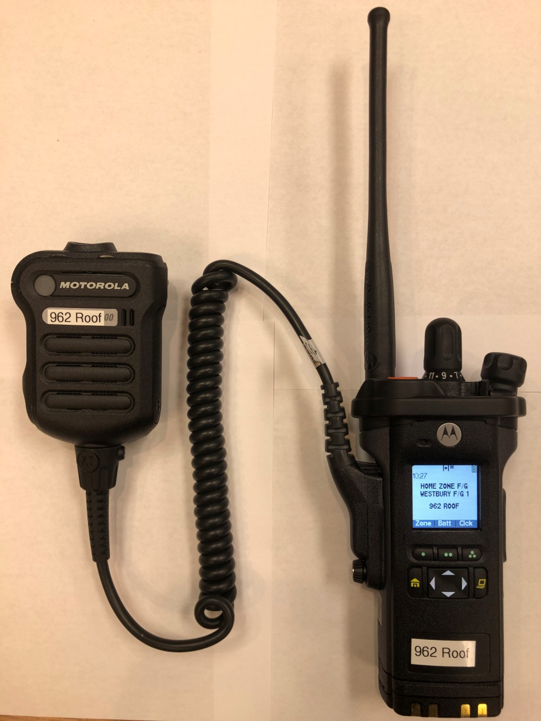
New Features
Voice Annunciation
(Announces channel)
Multi-Screen View
(Top screen & main display)
Mayday Retention
(Will hold last 15 transmissions)
Multi-Zone Capabilities
(Enhanced interoperability communications)
Multi-Band Radio
(VHF, UHF and 700/800 MHz)
Mini Light on Mic
(Operates on Emergency Activation & manually)
Alpha-Numeric ID
(Will display many more position-based ID’s)
Bluetooth Technology Built Within
(Future use purposes)
Notes:
There will be other enhancements, but our emphasis here is how does it work on the fireground.

Slide 3
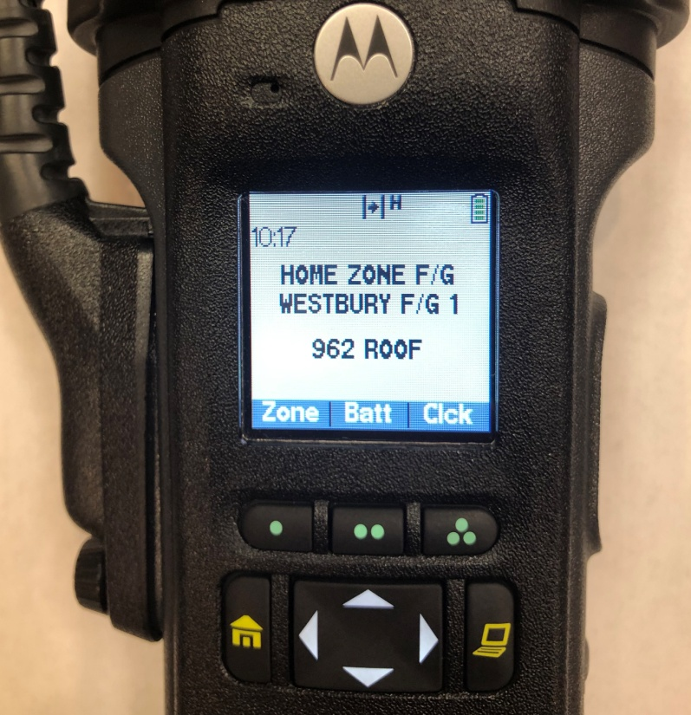
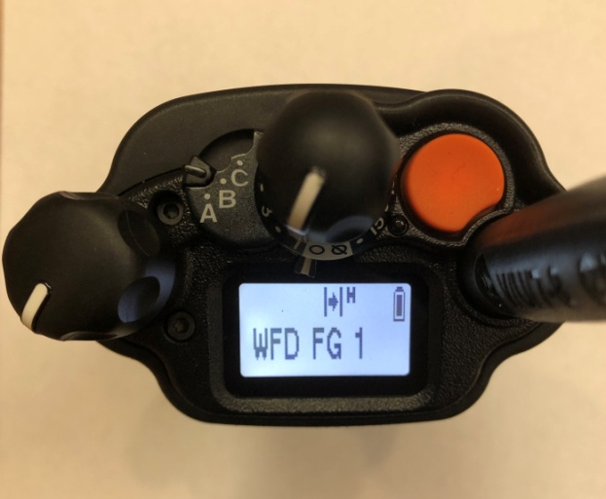
Top Display
Main Display
Channel Selector
Speaker
ABC Switch
(Unprogrammed)
EA Button
Battery Level
Indicator
Menu Select
Buttons
On/Off Volume
Control Knob
4-Way
Navigation
Button
Battery Level
Indicator
Concentric Switch
(Unprogrammed)
Channel Display
Home Button (Returns channel to ‘Westbury Fireground 1’ in ‘Home Zone Firegrounds’)

Slide 4
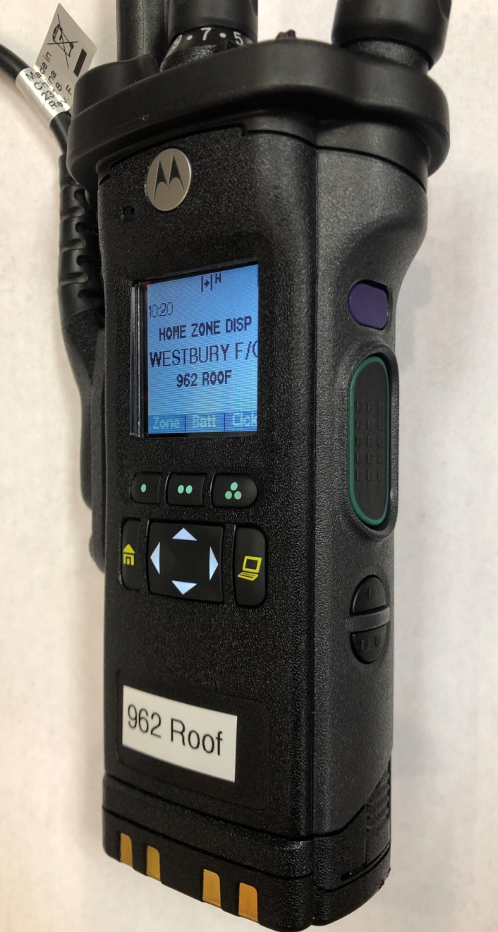
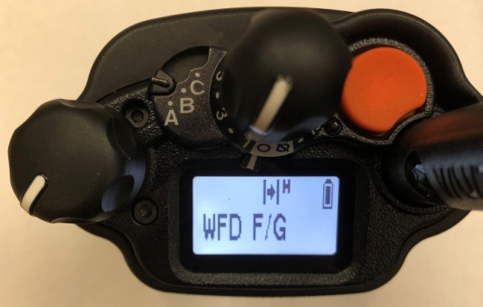
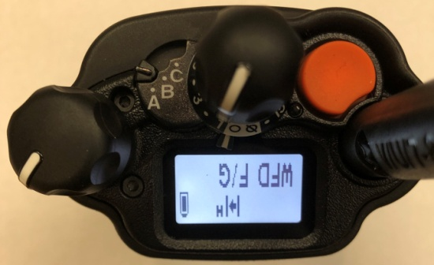
Top Side Button
Short Press - Illuminates Screen
Long Press - Reverses Orientation of Top Screen
PTT Button
Side Buttons 1 & 2:
1 - One Dot - Channel Annunciation
Announces current channel radio is selected on
2 - Two Dot - Recent Calls (Mayday Retention)
Will emphasize on details later
Notes:
Once learned it’s a lot easier than just trying to pull off w/o using thumb.

Slide 5
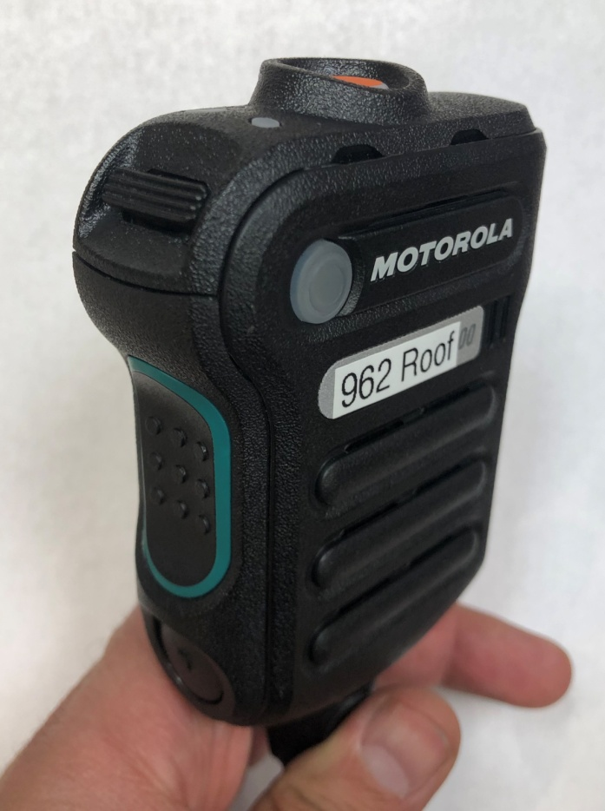
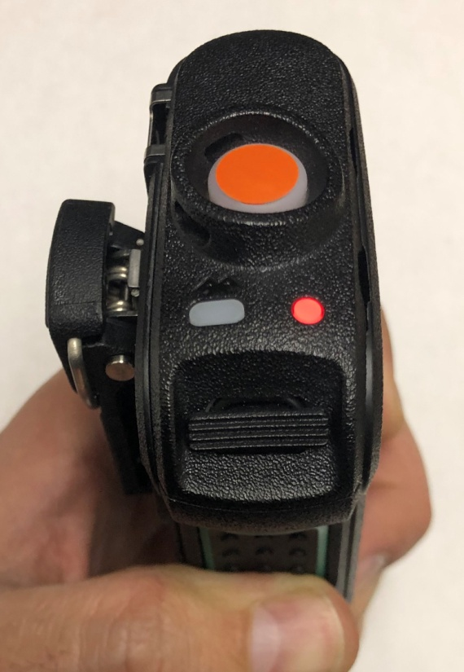
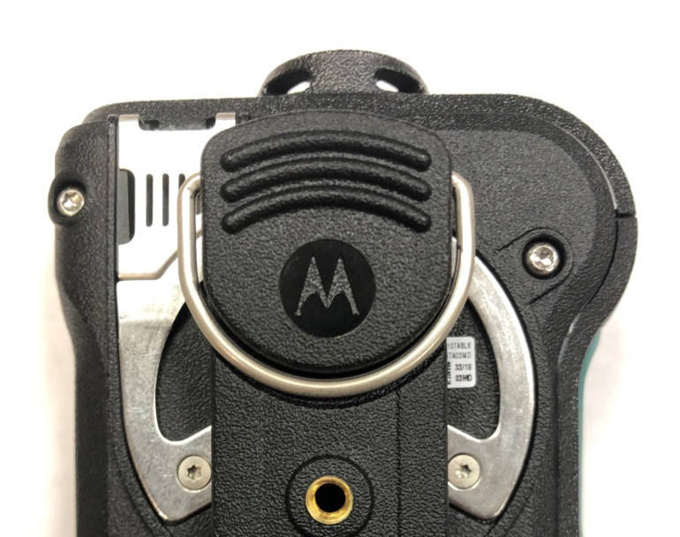
Remote Speaker Mic (RSM)
EA Alert Button
Transmit Light
Volume Up/Down Button
PTT Button
Channel Annunciation
Mini Light Mics
Rear Mic
Note: This RSM has 5 Mics on it: Front, Top, Back
Mic has noise cancelling features that
filter a significant amount of background
noise
Notes:
Demonstrate at front of room.

Slide 6
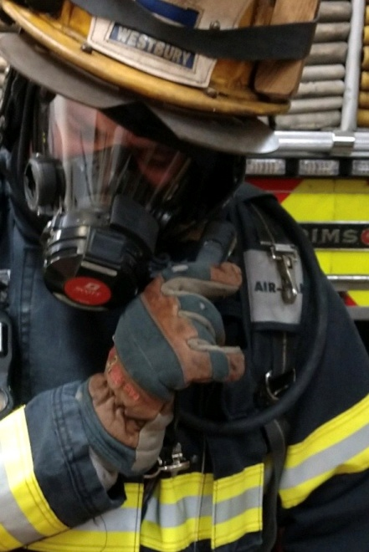
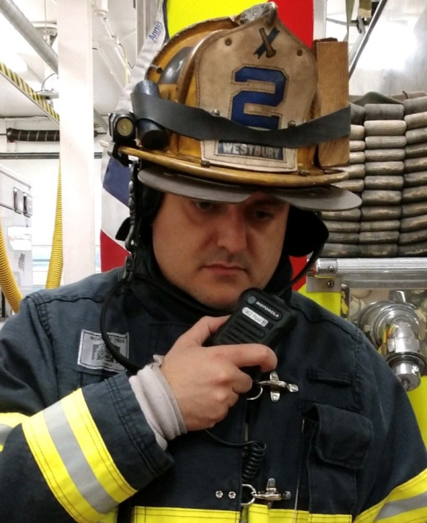
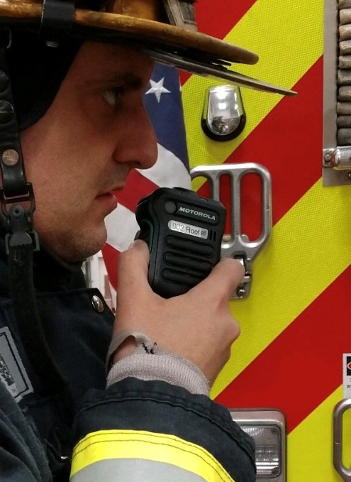
Transmitting When Using Scott Mask
Members MUST place Mic on Voicemitter
Transmitting Without Using Scott Mask
1 - Aim RSM towards mouth and 2 - Ensure hand does not cover Mics
drive transmission into Mics

Slide 7
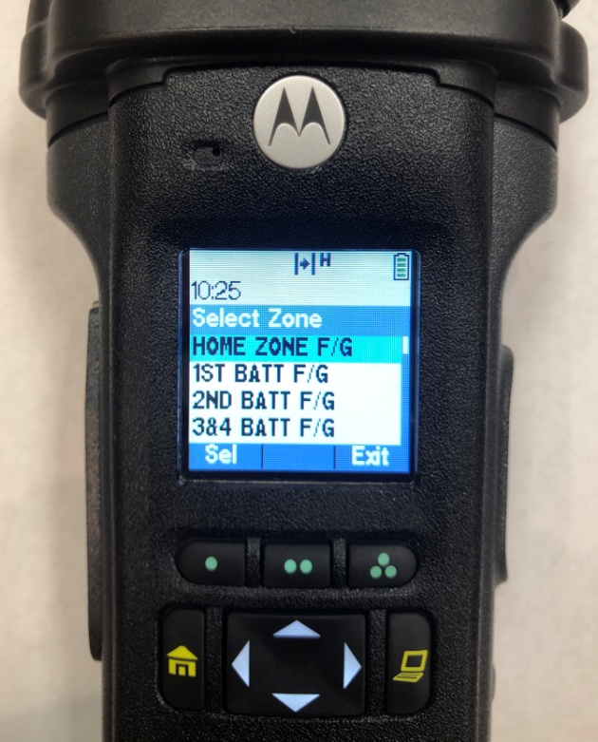
Changing Zones
Press Menu button beneath ‘Zone’
‘Select Zone’ screen will appear
Use 4 Way Navigation button to scroll up
and down to view different zones
Press Menu button beneath
‘Sel’ (Select) to select desired zone
Use Channel Selector Dial on top of radio to
select desired channel in chosen zone
Notes:
Emphasize, this procedure is simpler than any cell phone in that room, 3 button process.

Slide 8
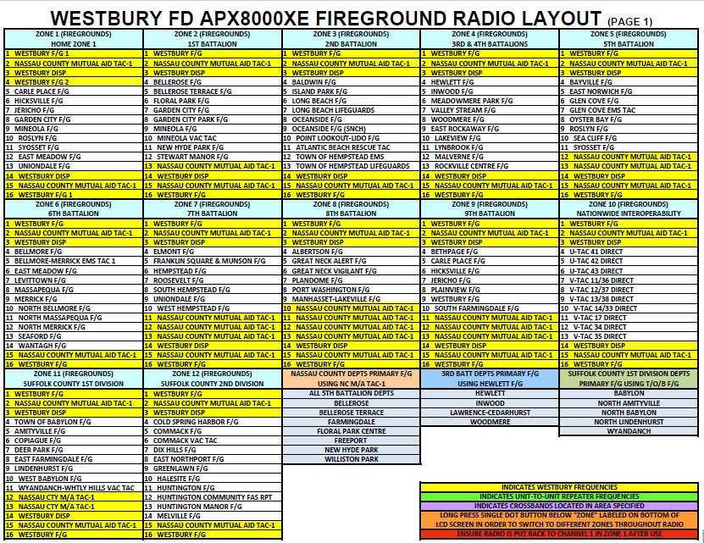

Slide 9
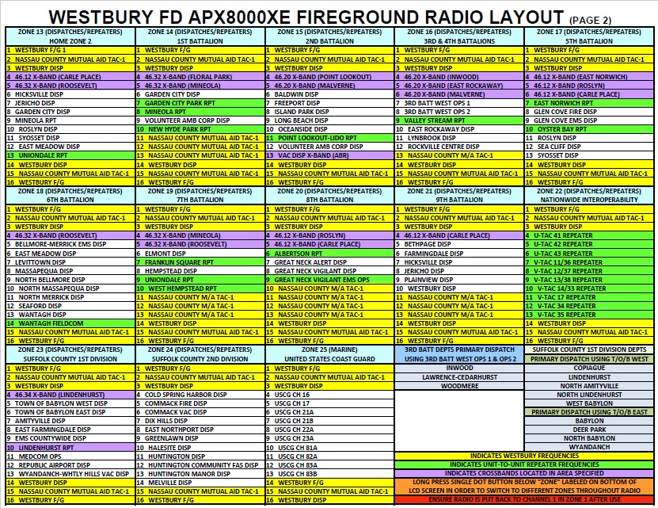

Slide 10
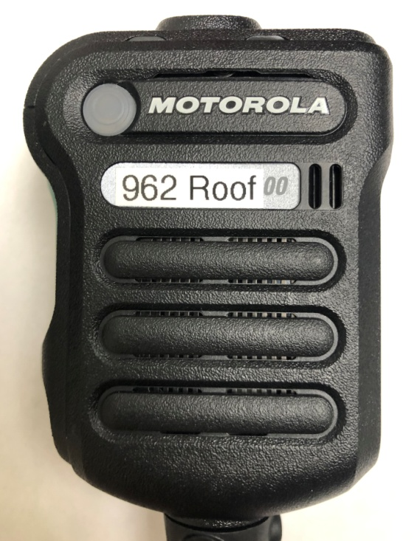
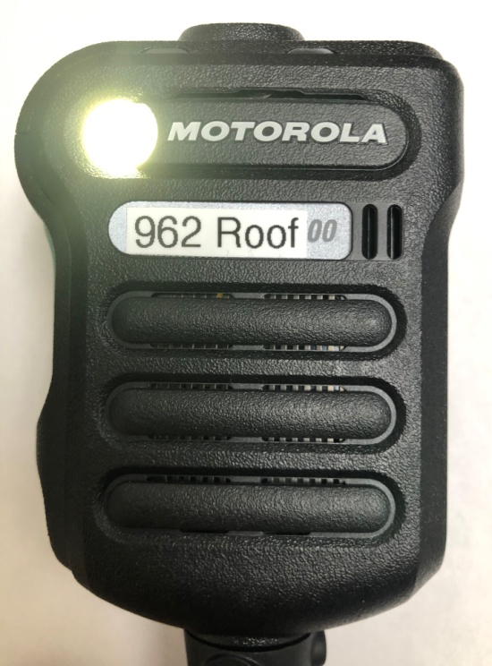
Mini Light Use
Press and hold light button down for
a couple of seconds to activate light
To turn light off, press and hold light
button for a couple seconds
Notes:
For use as needed. Not to remain on at all times. It could impact battery life. (Note: left light and radio on for 9 hours before low battery tone sounded)

Slide 11
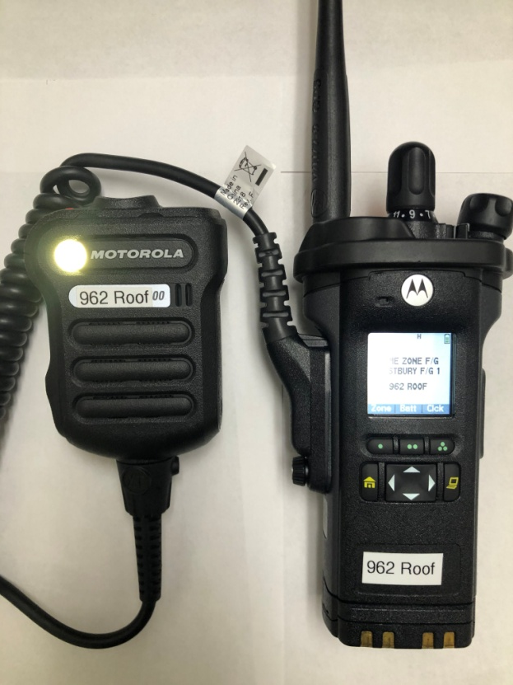
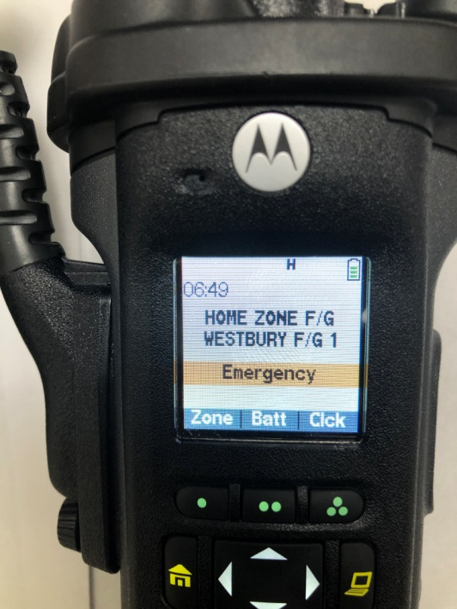
Emergency Alert Activation
By User
Mini light blinks out SOS signal
(3-Dots, 3-Dashes, 3-Dots)
Main screen displays ‘Emergency’ in an
orange stripe

Slide 12
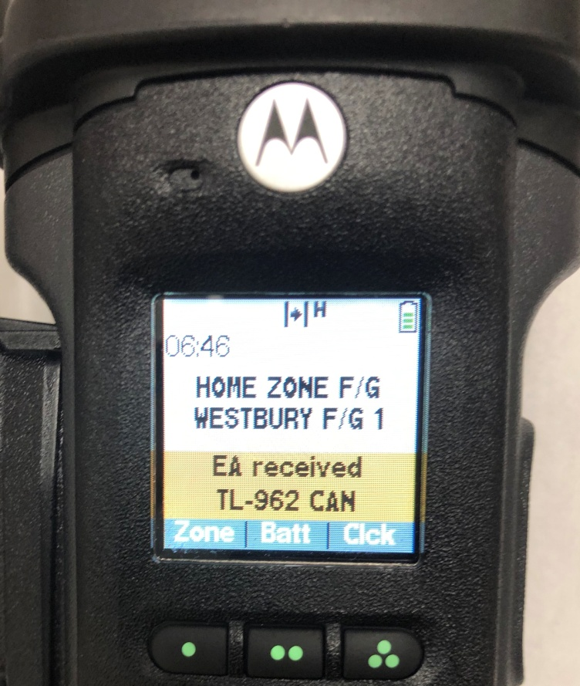
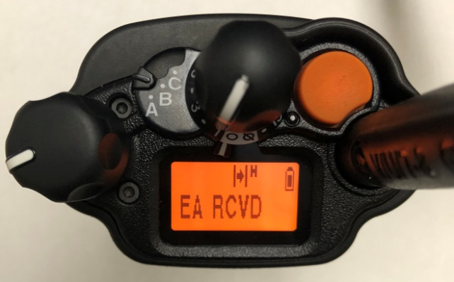
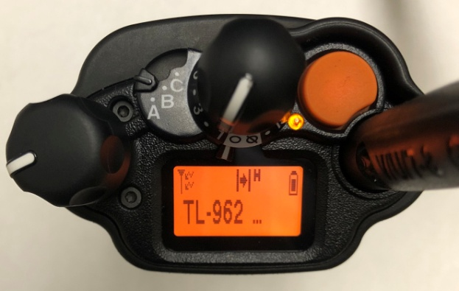
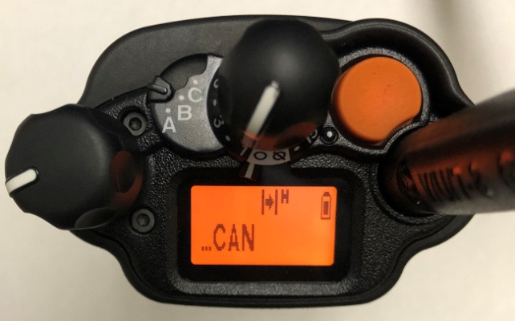
Emergency Alert Received
Main Display
Displays ‘EA received’
Also displays Alpha-Numeric ID of Radio
Holds display for approximately
8 seconds
Top Display
Displays ‘EA RCVD’
Alternates between EA RCVD and
Alpha-Numeric ID of radio giving EA
Holds display for approximately
8 seconds

Slide 13
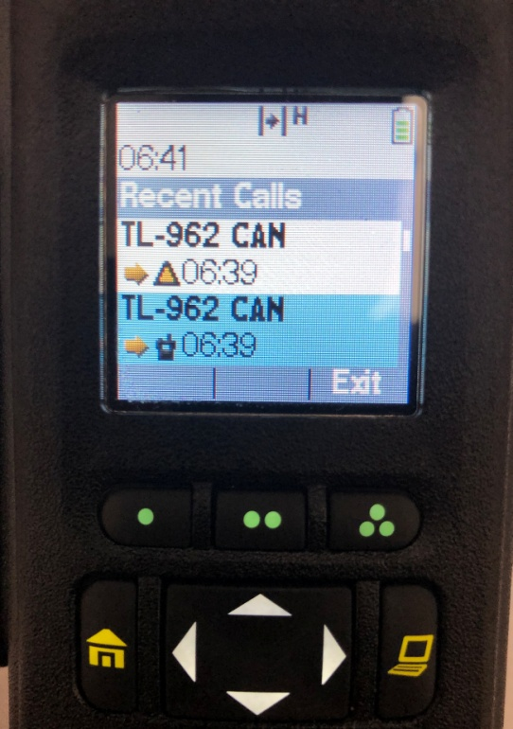
Recalling EA Activations
Press Two-Dot Button button under ‘Rcnt’ (Recent)
‘Recent Calls’ screen appears
The last 15 calls with radio ID will display from
most recent to the previous 15 calls
Each call is time stamped (Times may not be all
accurate on radios)
Calls that display a yellow Triangle were EA activated
transmissions.
Use 4 Way Navigation button to scroll up or down
for additional received transmissions.

Slide 14
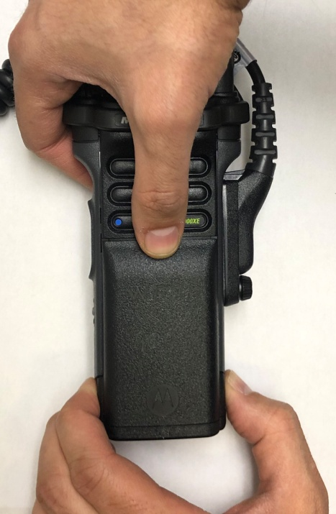
Battery Latch
One is located on each side
Removing Batteries
Squeeze battery latches on each side simultaneously
Push battery body down with thumb from other hand

Slide 15
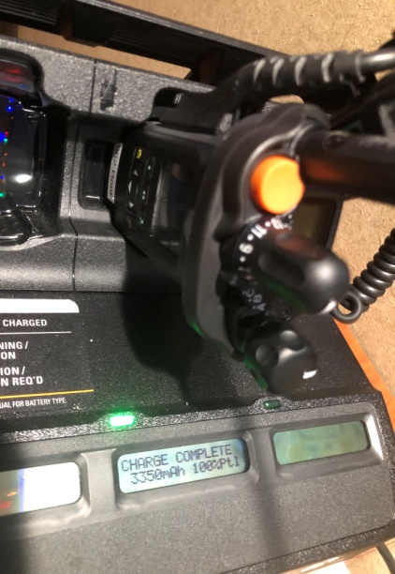
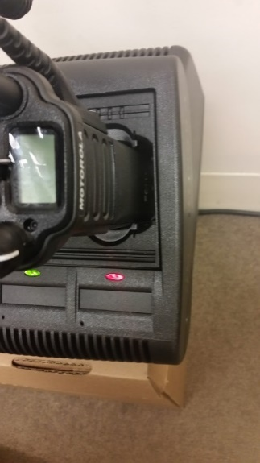
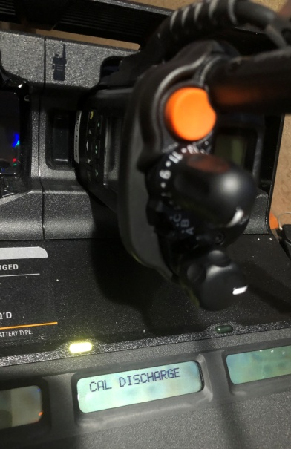
Charging Batteries
Batteries must only be charged in chargers specifically designated for use with the APX radios
Batteries can be in different states of charging, as identified by colored light designations
Only use batteries with one of the green light indications
Green Light
Steady Green - Fully Charged
Blinking Green - Trickle Mode
Charge is at 90% or better
Green/Amber Alternate Blinking -
Fully charged
(This indicator is for Radio Vendor
informational purposes only)
Red Light
Steady Red - In Rapid Charge
Blinking Red - Not Charging /Re-insert
Amber Light
Steady Amber - Is re-conditioning where current
battery level gets drained first then recharges.
Should transition to Red (charging) then solid Green, blinking Green or Green/Amber eventually
ONLY USE - STEADY GREEN, FLASHING GREEN, OR ALTERNATE BLINKING GREEN/AMBER BATTERIES

Slide 16
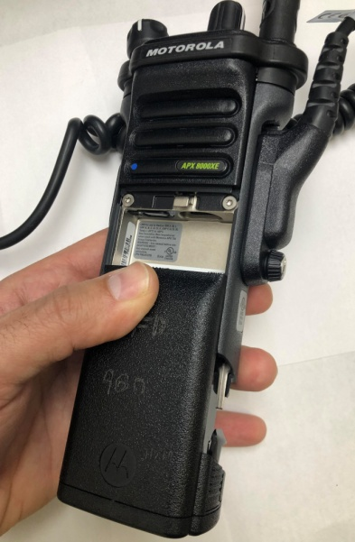
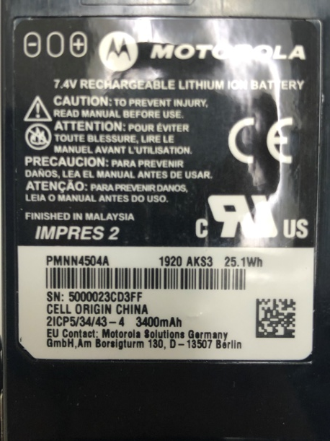
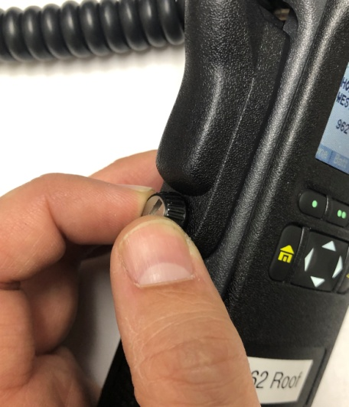
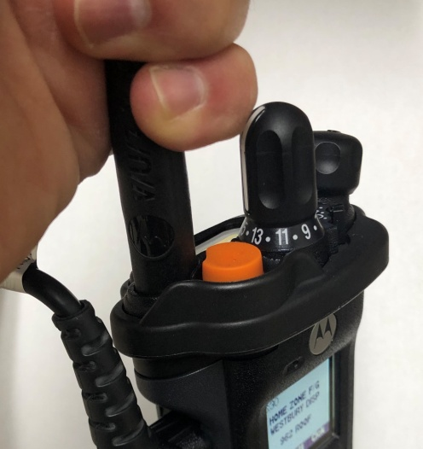
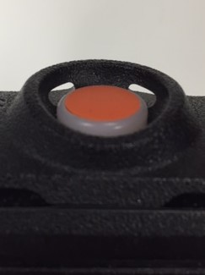
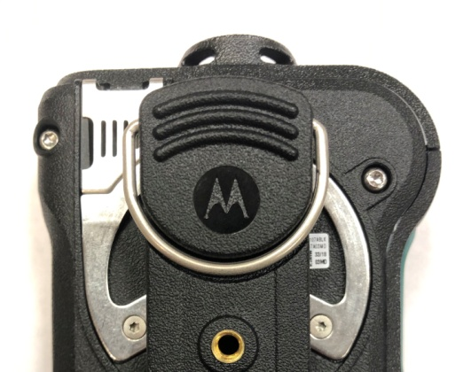
Weekly Maintenance & Inspection
1 - Change Battery Weekly
Retrieve battery from gang charger
Check 4 digit Date Code to ensure battery has not exceeded life use capacity
Date Code (Manufactured Date)
First 2 digits represent Year
Last 2 digits represent Week
Insert battery into portable radio and ensure clicks are heard and battery is seated properly
2 - Ensure Remote Mic
security screw is tight
3 - Ensure antenna is secure,
hand tight
4 - Ensure Rear Mic and EA Button are clear of debris
Note: Ensure channel is set to WESTBURY F/G 1 in HOME ZONE F/G

Slide 17
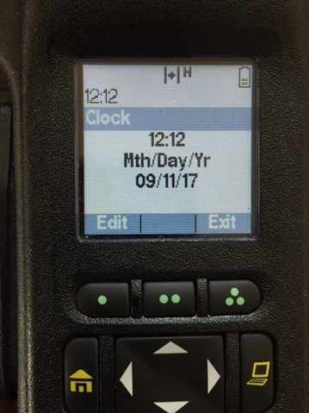
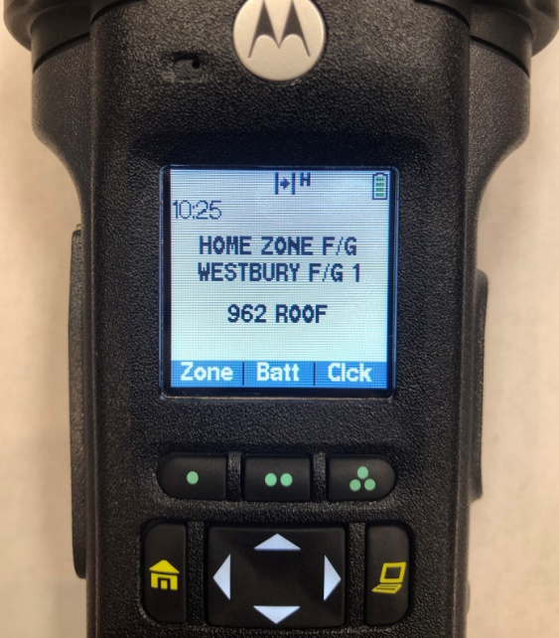
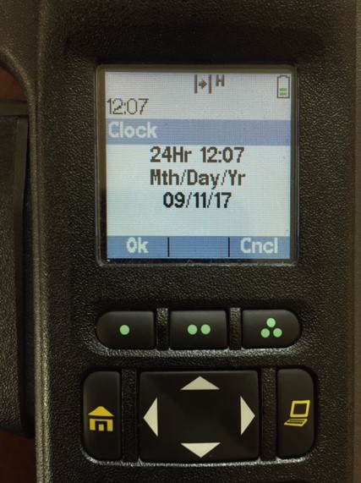
Setting Time
The times on the portable radios are not synchronized and may be slightly off
Additionally, the times must be reset for Standard and Daylight savings
time
2 - Click button under ‘Edit’
3 - Use Navigation Button
to adjust time and date
4 - Click button under ‘Ok’
when done
1 - Click button under
‘Clck’ (Clock)

